Slide 1

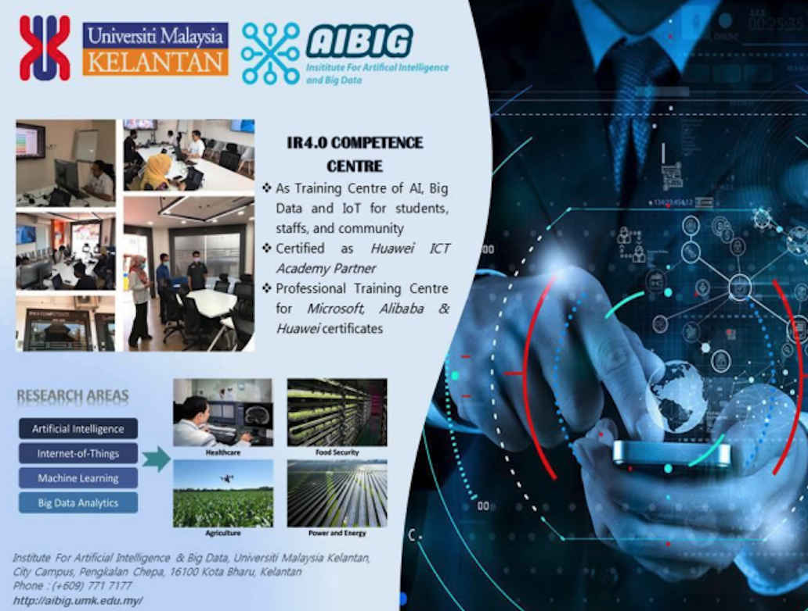
INSTITUTE FOR
ARTIFICIAL
INTELLIGENCE AND BIG
DATA (AIBIG)

Slide 2



Digital@UMK
INSTITUTE FOR ARTIFICIAL INTELLIGENCE AND BIG DATA (AIBIG)
Centre of Excellence (CoE) for Research and Innovation in AI and Big Data
FACULTY OF DATA SCIENCE & COMPUTING (FSDK)
Newly established faculty in offering foundation, undergraduate and postgraduate program related to Data Science

Slide 3
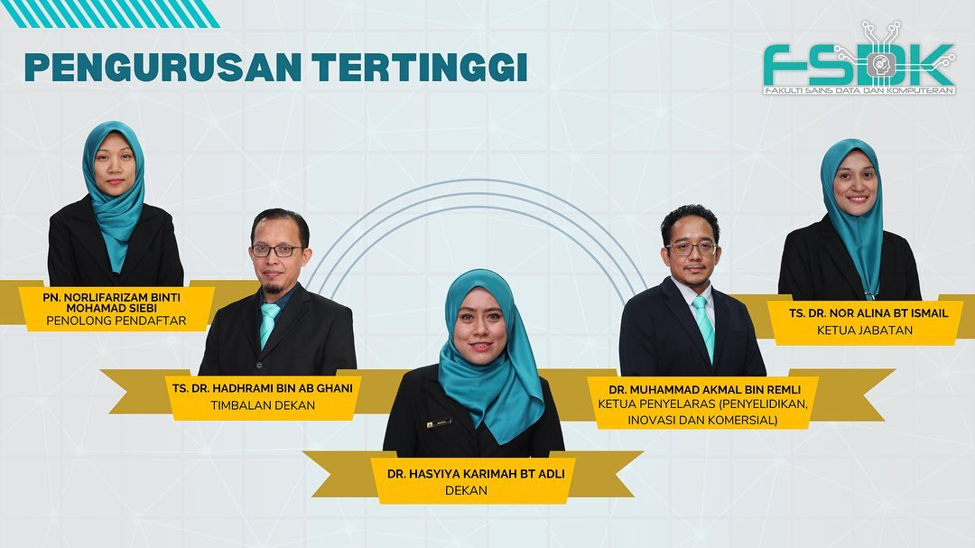
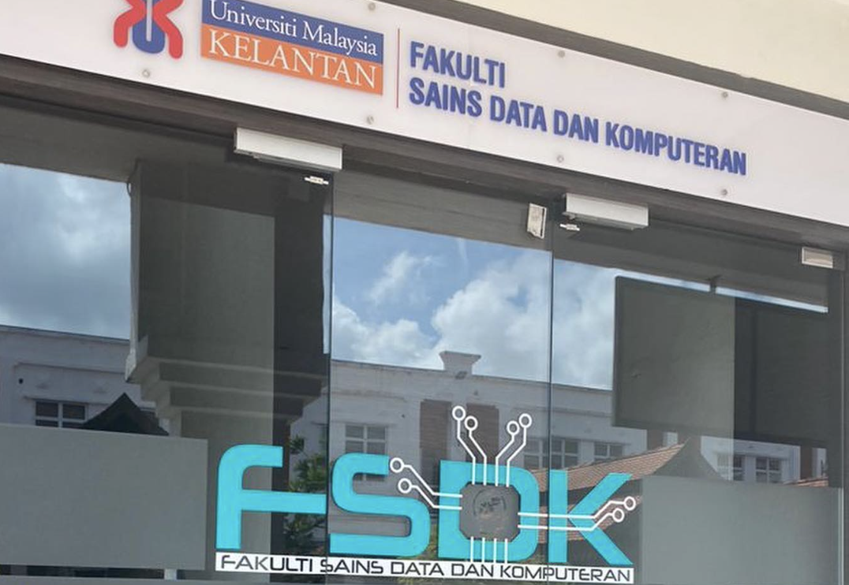
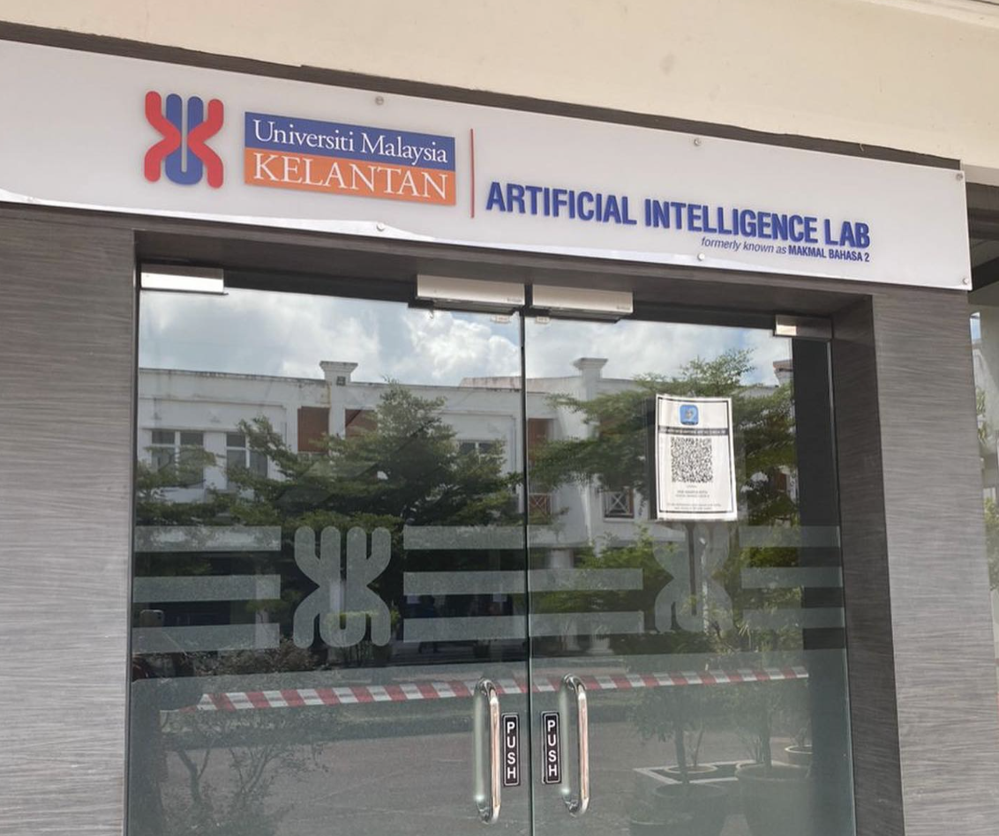
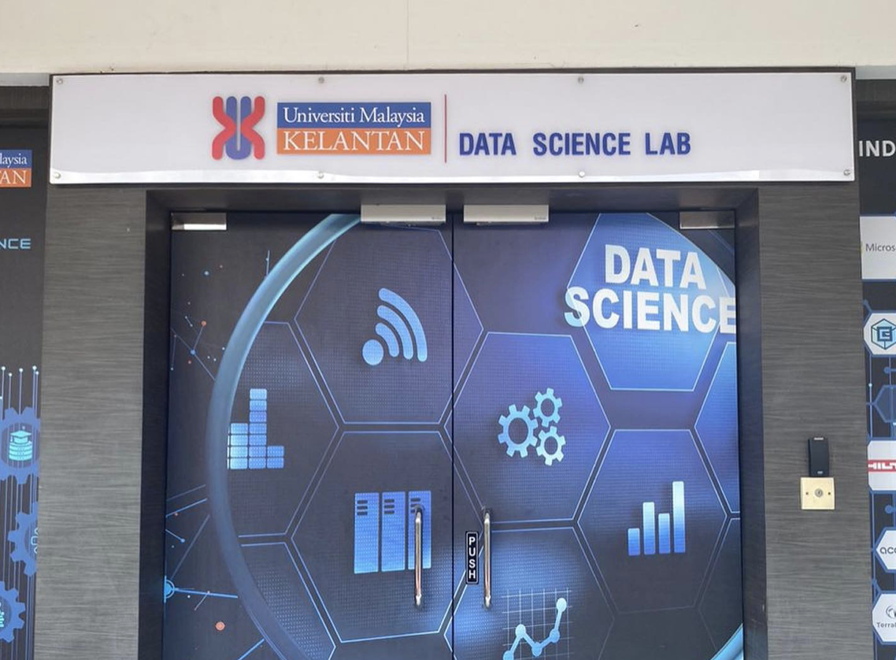
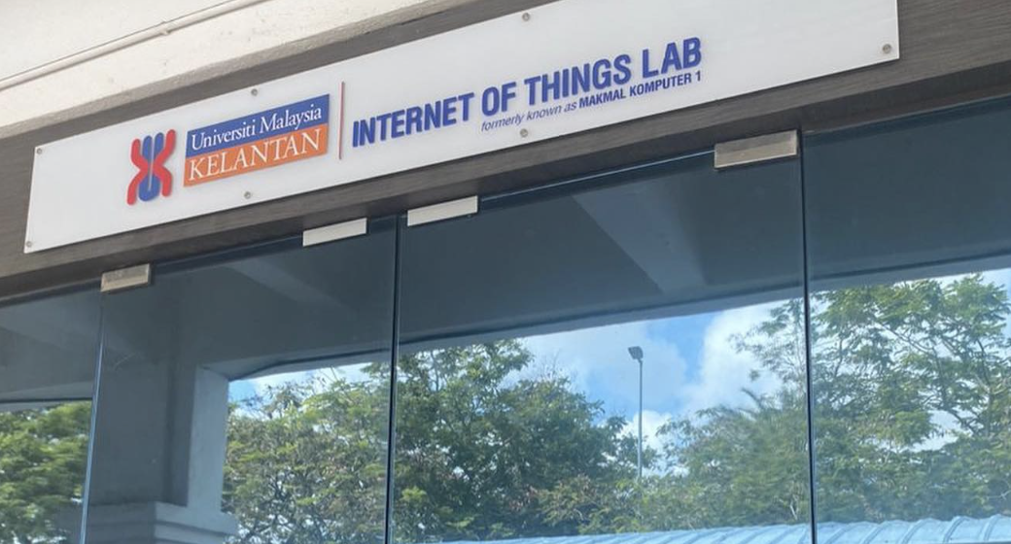
Faculty of Data Science & Computing (FSDK)

Slide 4
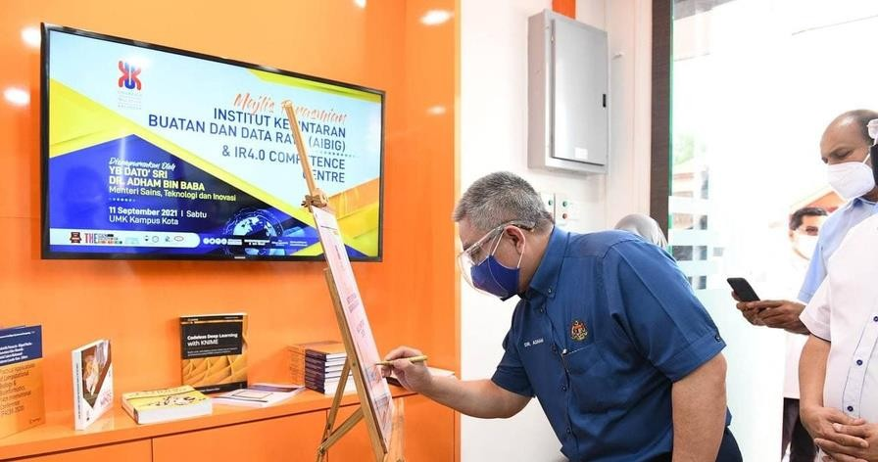
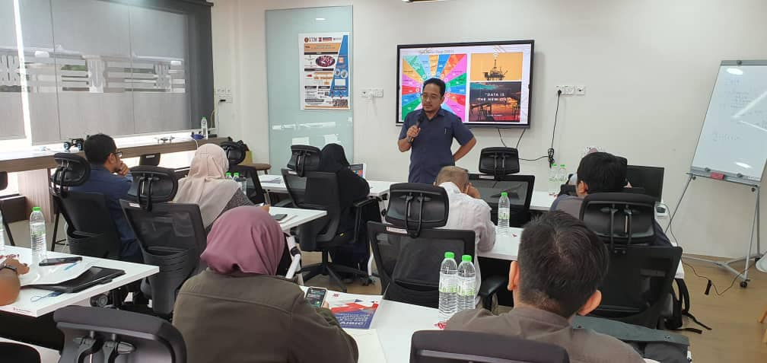
Institute for Artificial Intelligence and Big Data (AIBIG)
As Centre of Excellence (CoE), established in September 2017.
Located at UMK City Campus, Pengkalan Chepa,
Kelantan.
http://aibig.umk.edu.my/
Facility: IR4.0 Competence Centre funded by MOHE
As Training Centre – To train and expose AI
and Big Data For Students, Staffs, and Community
Certified as Huawei ICT Academy Partner starting 21 Aug 2019
Professional Training Centre for Microsoft, Alibaba & Huawei certificates
IR4.0 Competence Centre

Slide 5
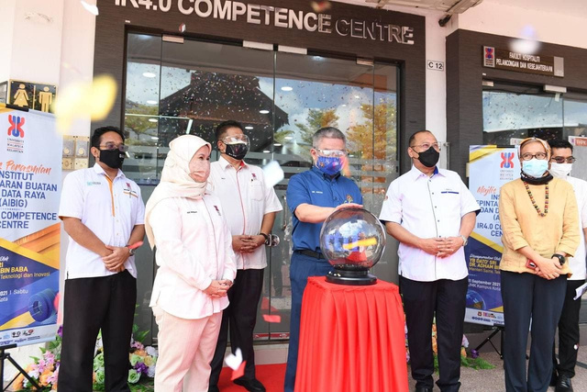

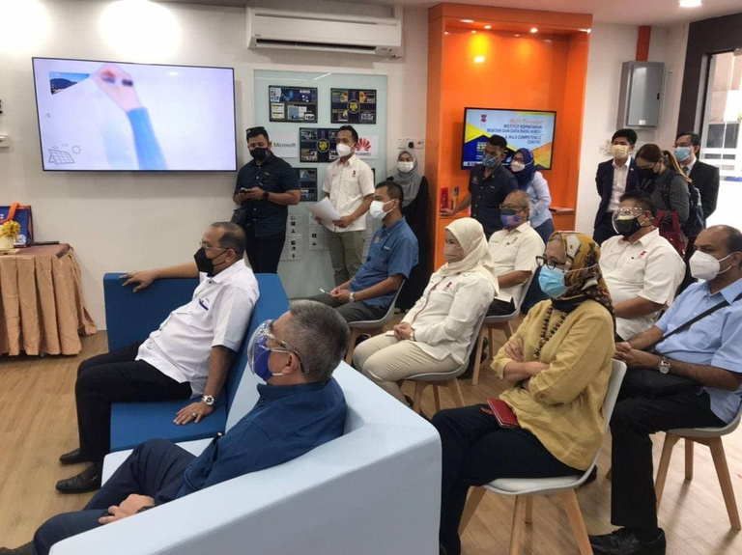
VISION, MISSION AND OBJECTIVES
VISION
TO BE A PREMIER GLOBAL INSTITUTION
THAT EXCELS IN AI AND BIG DATA.
TO LEAD IN THE DEVELOPMENT OF HOLISTIC TALENTS AND INNOVATIVE TECHNOLOGIES IN AI AND BIG DATA FOR UNIVERSAL WELL-BEING AND PROSPERITY
MISSION
•TO RESEARCH AND DEVELOP THEORY,
TECHNOLOGY AND APPLICATION OF IR4.0
ESPECIALLY IN AI AND BIG DATA.
•TO ENGAGE AI AND BIG DATA WITH INDUSTRY
PLAYERS.
•TO PRODUCE TECHNOPRENEUR IN AI AND BIG
DATA.
•TO GIVE TRAINING OF AI AND BIG DATA FOR
SOCIETY.
OBJECTIVE
IR4.0 Competence Centre

Slide 6
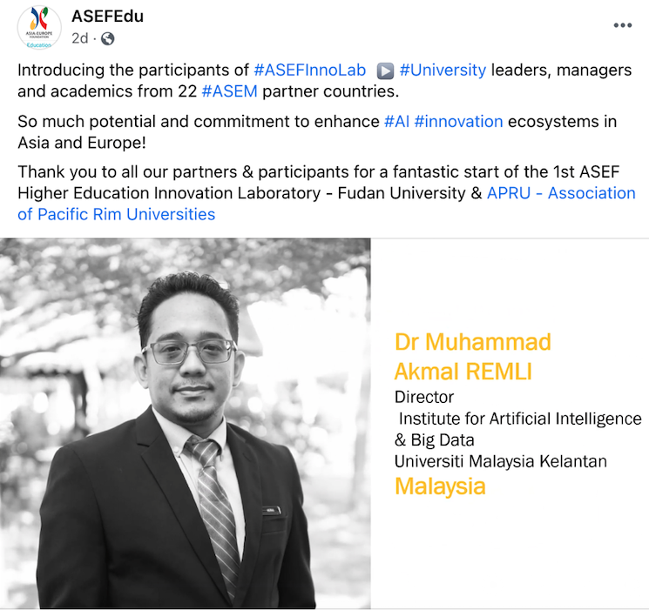
From Director Desk
The objectives of AIBIG is to conduct research and development in AI and Big Data towards the Fourth Industrial Revolution (4IR), engage AI and Big Data with industry players, produce technopreneur in AI and Big Data and give training of AI and Big Data for society.
In terms of research collaboration, currently, we have national and international collaborators that have distinction expertise and a wide range of disciplinary and backgrounds. We want to extend a very warm welcome to all new and prospective students and invite collaborations from researchers around the world.

Slide 7
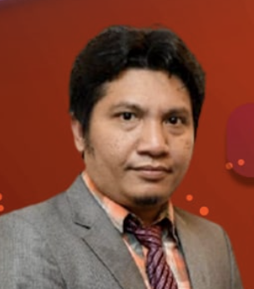
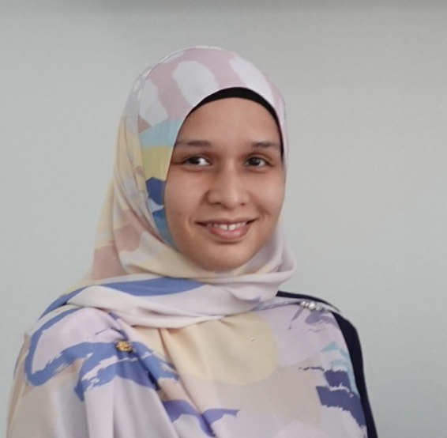
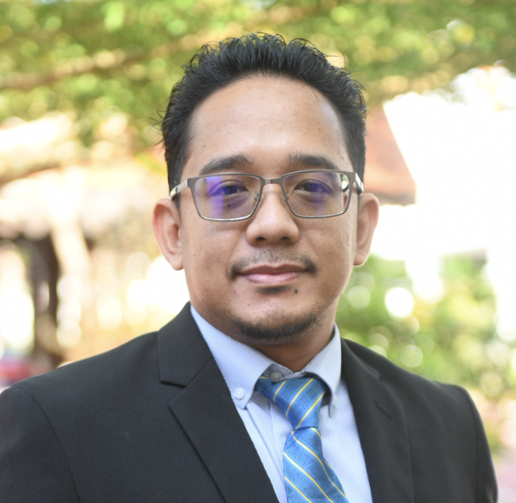
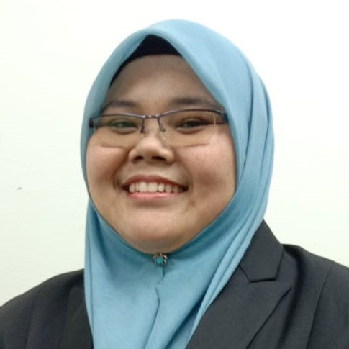

AIBIG FELLOW
Ts. Dr. Mazlan Mohamed
Industrial Relation Unit
Ts. Dr. Nooraziah Ahmad
Artificial Intelligence Unit
Dr. Muhammad Akmal Remli
Director
Dr. Ruhil Hayati Hamdan
Big Data Unit
Dr. Marieanne Christie Leong
Training and Consultation

Slide 8
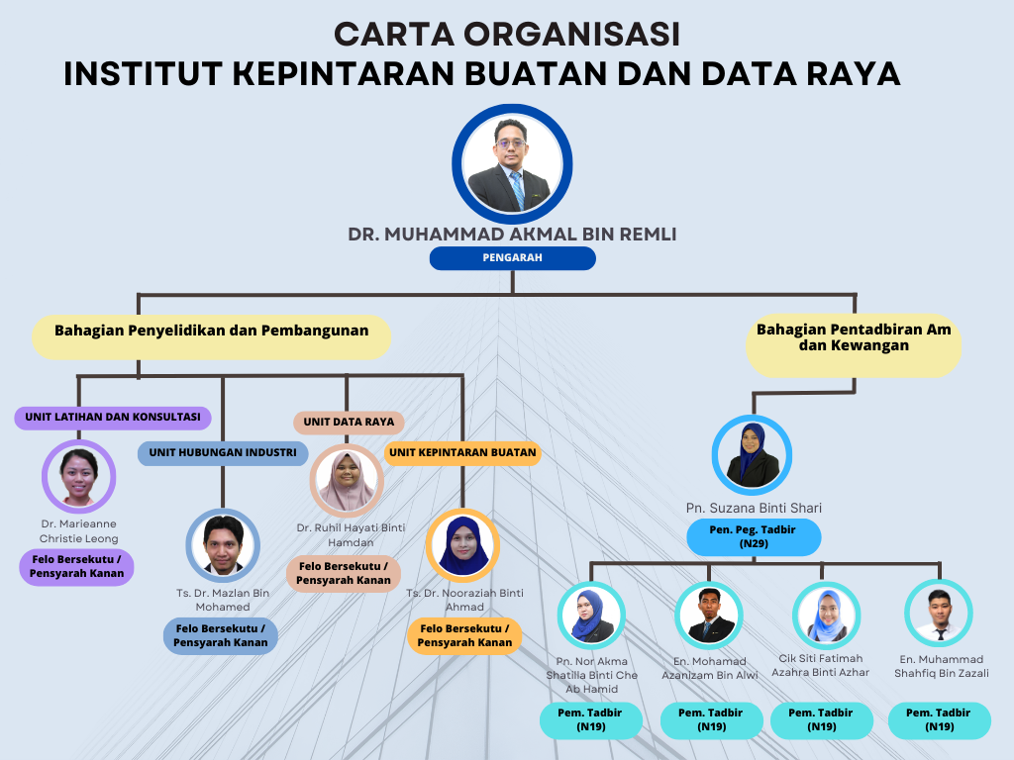
Our Staff
Associate Fellow: 5
Admin: 5
Total: 10
Postgraduate: 10
Postdoc : 4
Visiting Researcher: 5
Research Member: 5

Slide 9
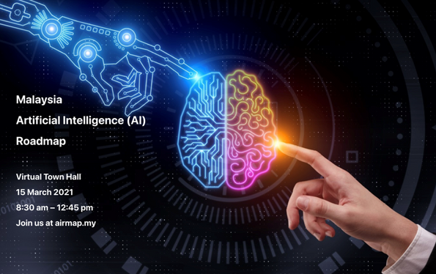


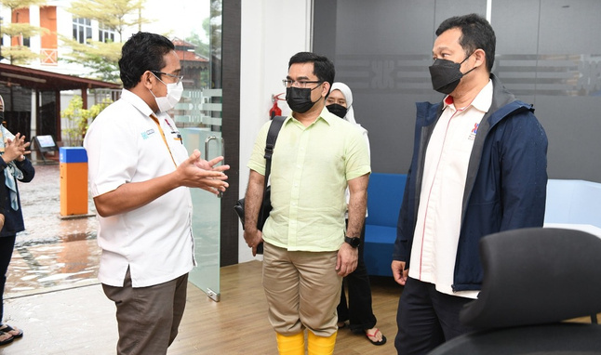

GRANT INDUSTRY4WRD-FACILITIES
The purpose of this funding package is to expand the Competence Center by equipping university facilities with IR 4.0 technology.
Total Grant: RM400,000
Niche Technology Drivers Industry4WRD UMK:
- Artificial Intelligence and Big Data Analytics

Slide 10




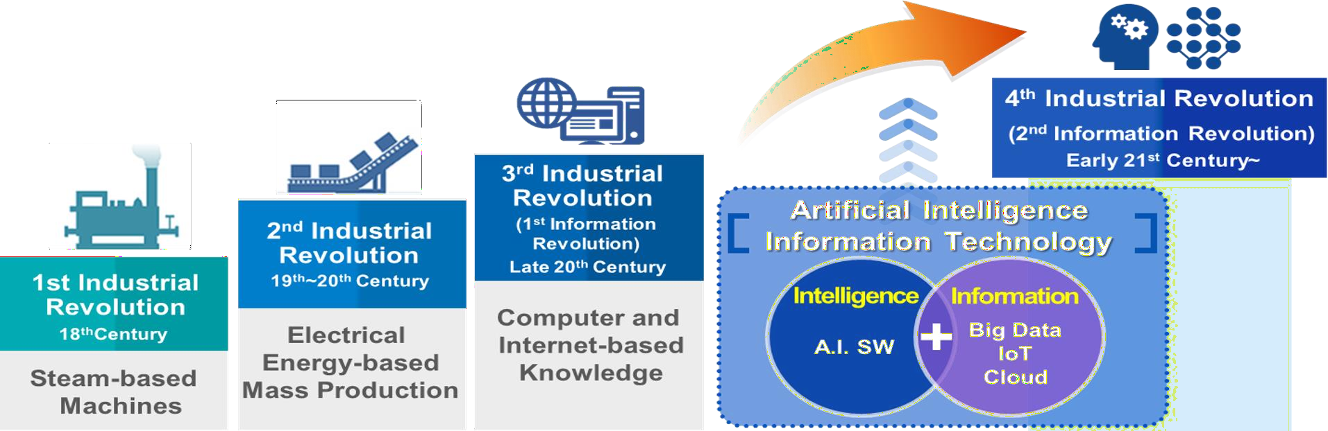
Background of AIBIG

Slide 11

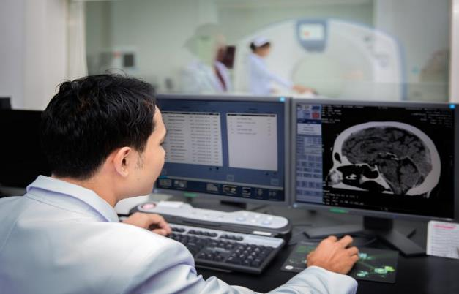
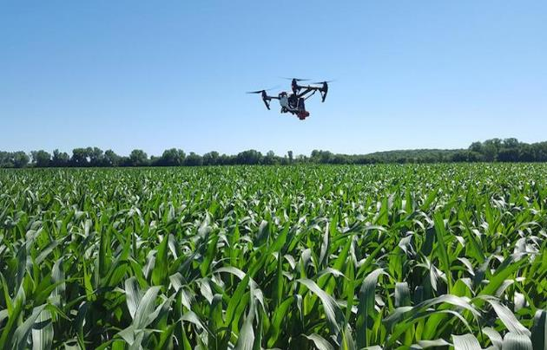

OUR CURRENT RESEARCH DOMAIN
Artificial Intelligence
Healthcare
Internet-of-Things
Creative Industry
Machine Learning
Big Data Analytics
Agriculture
Power and Energy

Slide 12
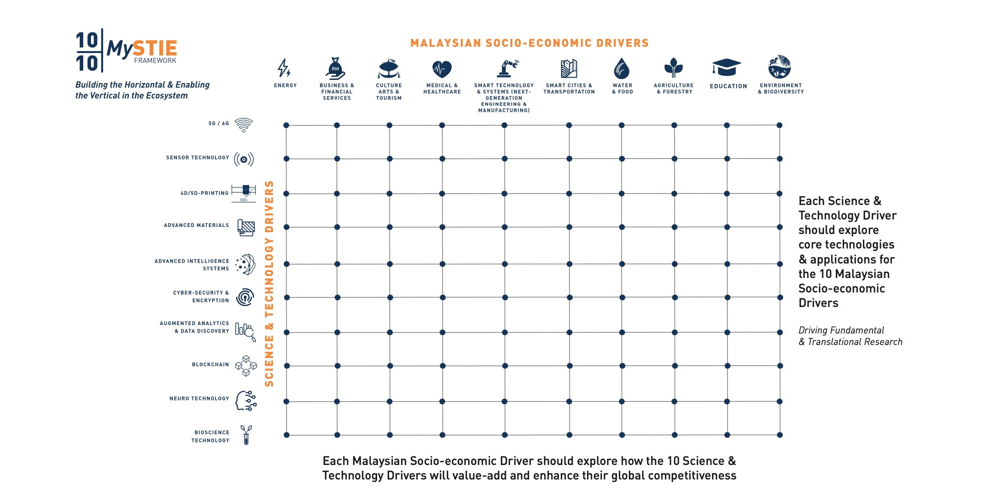
Supporting Government Policies at UMK
FKP
FAKULTI KEUSAHAWANAN DAN PERNIAGAAN
FTKW
FAKULTI TEKNOLOGI KREATIF DAN WARISAN
FPV
FAKULTI PERUBATAN VETERINAR
FIAT
FAKULTI INDUSTRI ASAS TANI
FBKT
FAKULTI BIOKEJURUTERAAN DAN TEKNOLOGI
FSB
FAKULTI SAINS BUMI
AIBIG ROLE

Slide 13










Industry Collaborators
Artificial Intelligences (AI)
Big Data

Slide 14






Industry Collaborators
Internet-of-Things
Smart Manufacturing

Slide 15
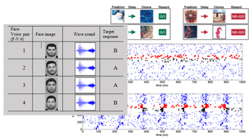
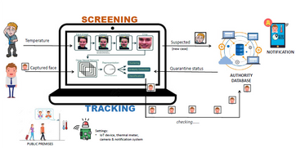
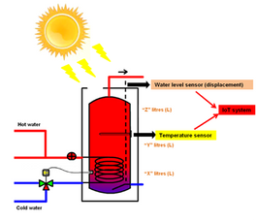
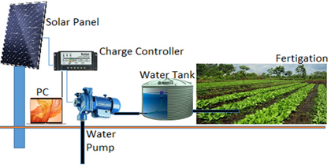
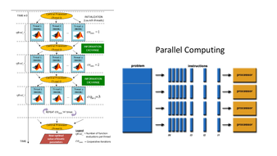
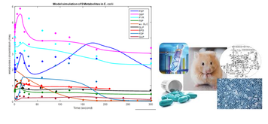
Research and Development at AIBIG
Artificial Intelligence
Internet of Things (IoT)
Machine Learning
A Smart Solar Water Heater with Internet of Things (IoT) Technology for Domestic Hot Water.
A Hybridization Schema of Discriminative Hand-Crafted and Features Learning for Kinship Verification.
Deep Learning in Genomics, Proteomics, Metabolomics (Multi-Omics) for Cancer Analysis in Healthcare Industry.
COVID-Face: Facial Recognition Tracking for COVID-19.
A New Semi-supervised Algorithm in Spatio-Temporal Neural Networks for Sequence of Events Detection.
Cancer Classification (Single and Multi-Class) based on Gene Expression and Pathway Data using Machine Learning Algorithms.e Industry.
An Evolutionary Algorithm for Community Detection Using an Improved Mutation Operator.
Tilt Angle Analysis of Solar Panel using Internet of Things (IoT) Monitoring for Fertigation System.
Echo State Network with Dynamic Reservoir Computing for Time Series Forecasting in Cyber Intrusion.
Text Simplification using Hybrid Semantic Compression and Support Vector Classifier for Troll Threat Sentences.
Model Calibration (Parameter Estimation) using Metaheuristics Optimization Methods in Dynamic Biological Model.
Perovskite as Ammonia Gas Sensor Equipped with Internet of Things (IoT) System System.
Big Data
Big Data and Parallel Computation for Solving Optimization Problems.

Slide 16
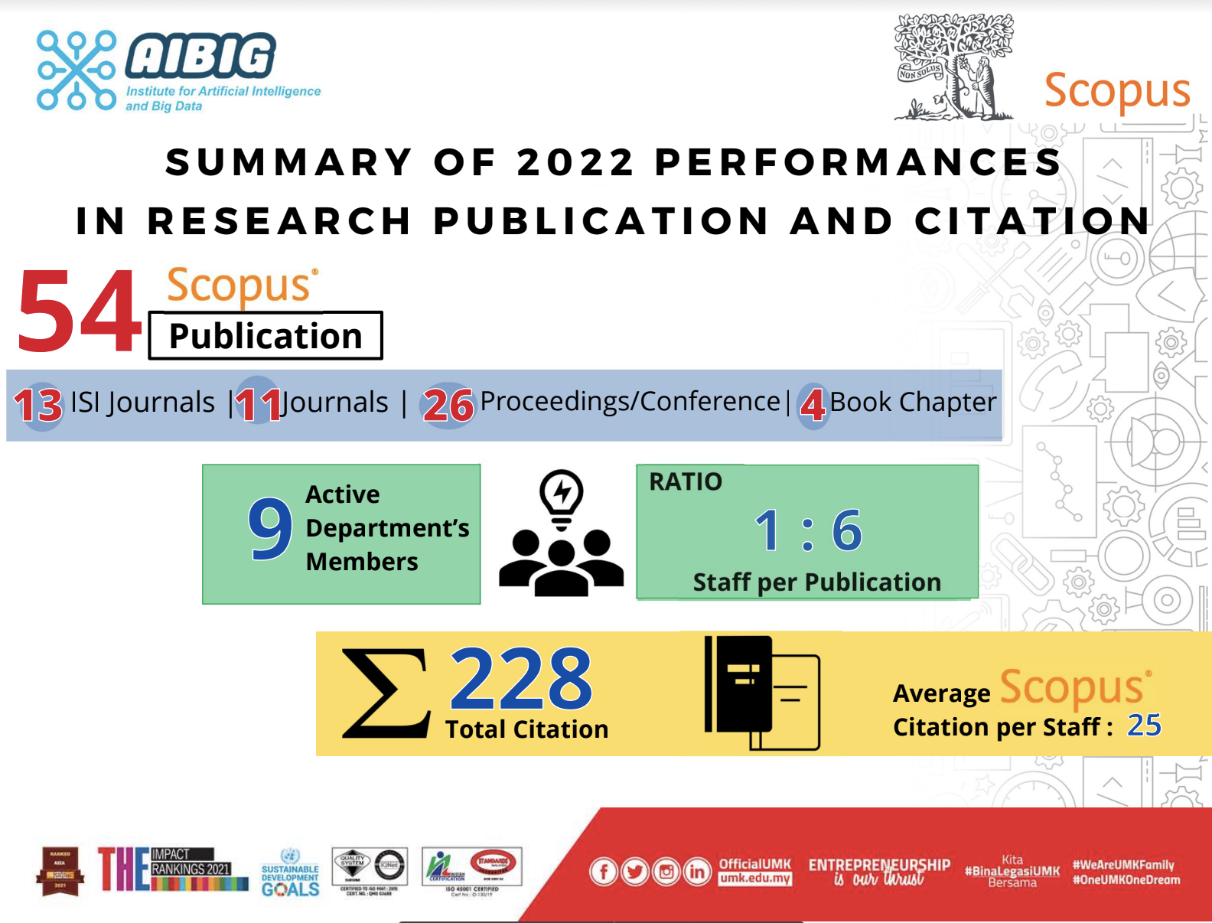
Publication 2022

Slide 17
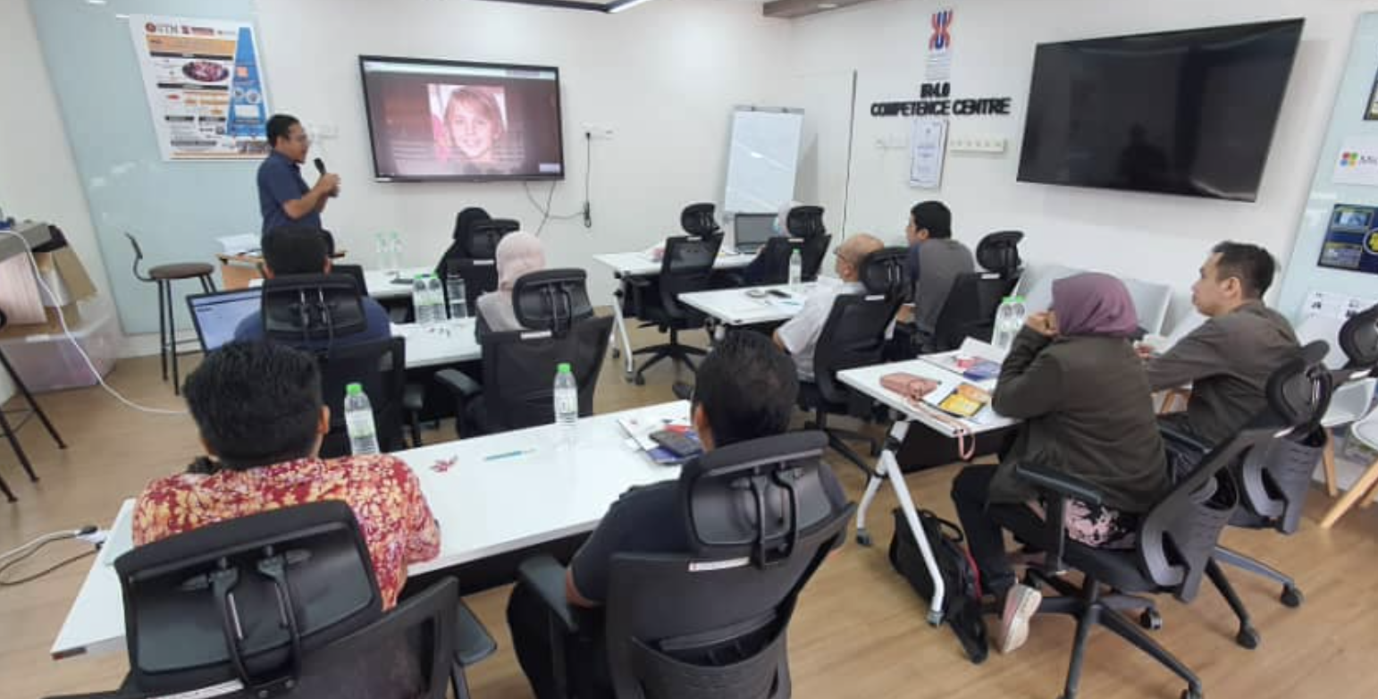
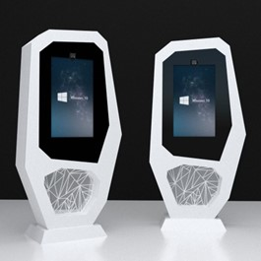
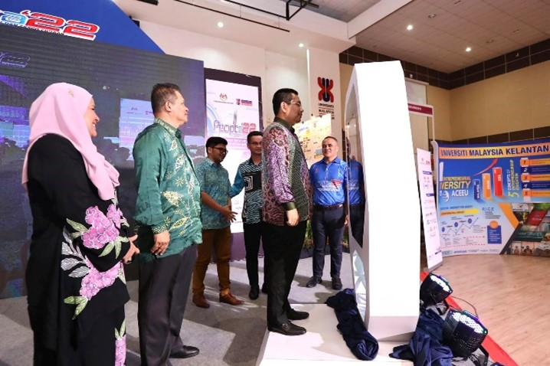
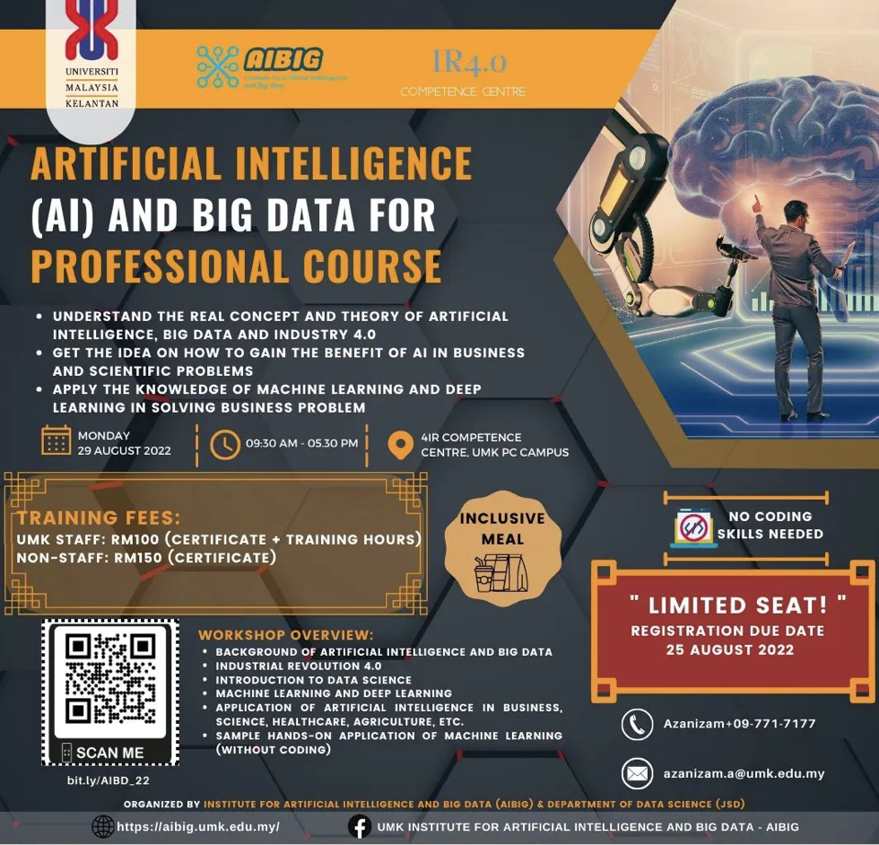
Key Achievement 2022
Jabatan Sains Data (JSD) - Hakiki
Permohonan Fakulti Baru FSDK
Program baru Bachelor of Data Science (DS)
Pembelajaran dan Pengajaran (PnP)
PG Supervision
IEEE Conference
Research Publication, etc
2. Research and Consultation
TNBR (RM400,000.00) Pullout
JPA (RM130,000.00) – IoT Training for Manager and Executive
3. Competence Centre Training (Dana RM400,000.00 from KPT and 150,000.00 from UMK)
Artificial Intelligence and Big Data for Professional Course - August
Data Analytics with Python - November
Codeless Data Science with KNIME – November
MDEC – Artificial Intelligence Listing Course
Alibaba Workshop on Cloud Computing in conjunction with Pecipta
4. MoU Industry
Alibaba Cloud (Alibaba Cloud Certification)
5. PECIPTA 22 Product
Gimik Perasmian berkonsepkan AI (Face Recognition)
6. Grant Application
5 Applications (3 International, 2 Local)

Slide 18
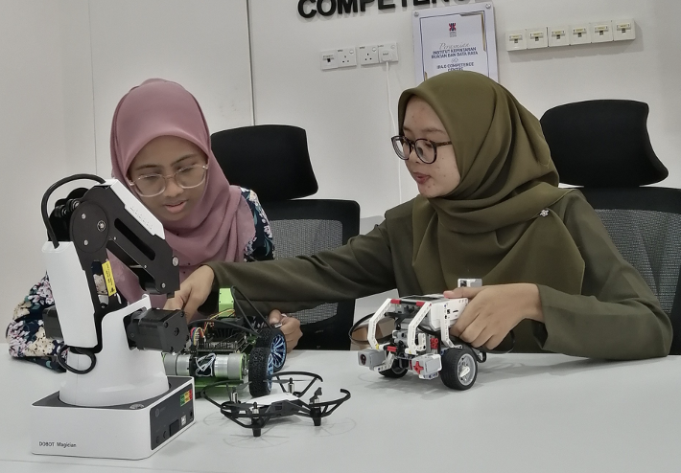
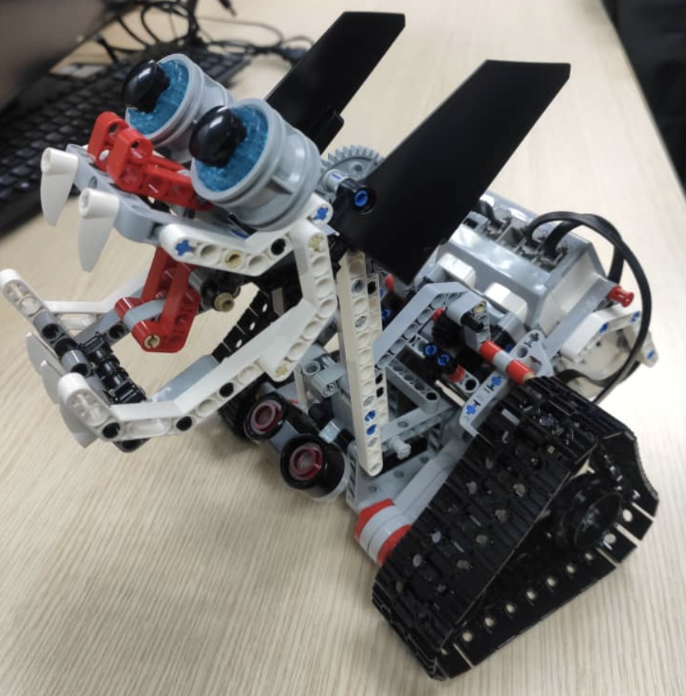
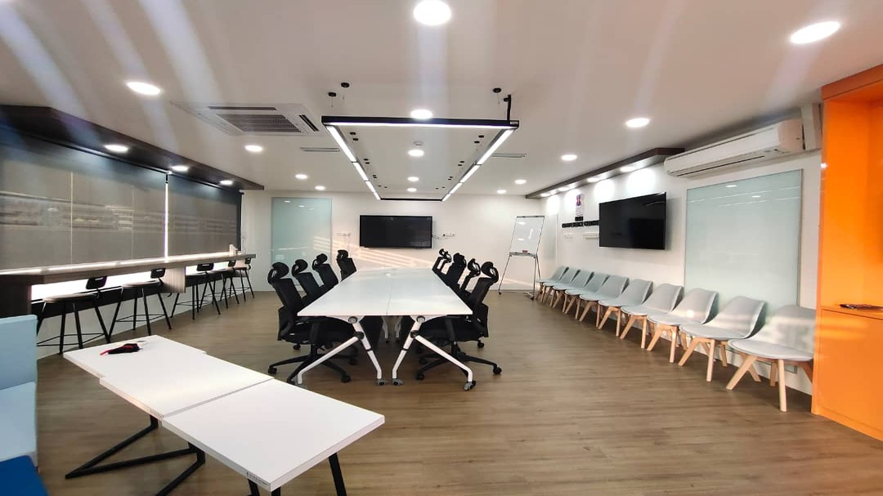
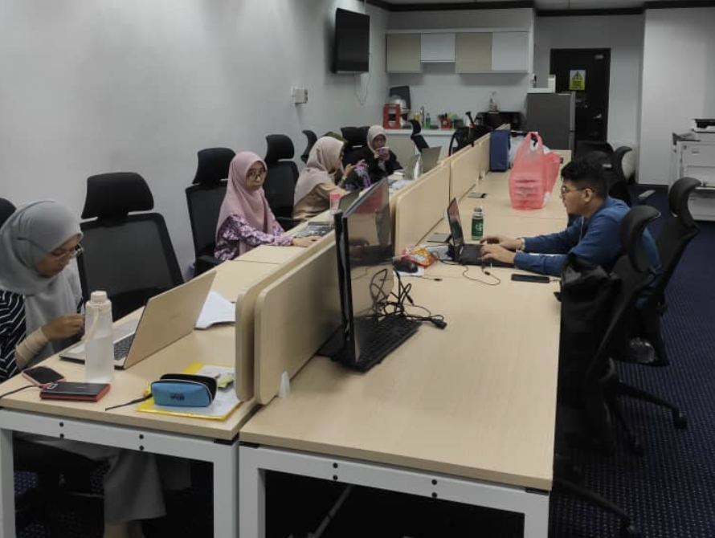
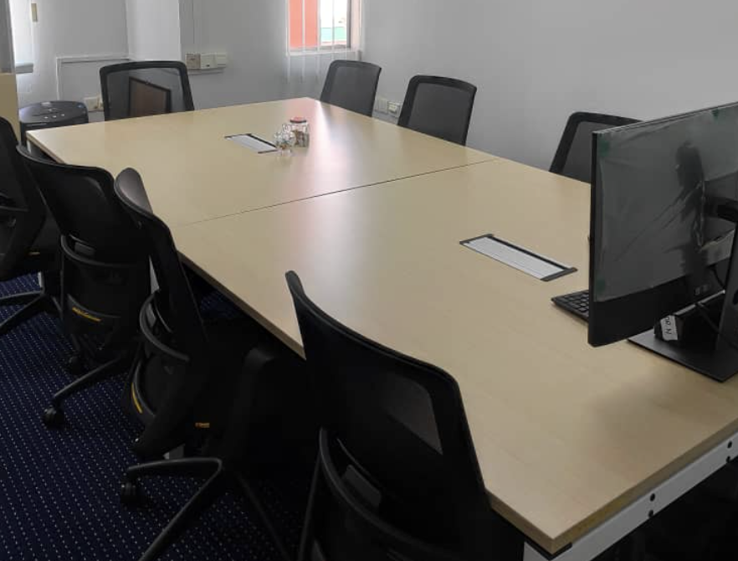
Facilities and Equipment's
4IR Competence Center – Latihan, Bengkel dan Mesyuarat
Working Space – For Postgraduate Student / Intern / Research Assistance / Research Officer
IoT Devices – IoT Project related and Training
Other Devices - Lego Mindstorms, Robot Arm, Drone

Slide 19
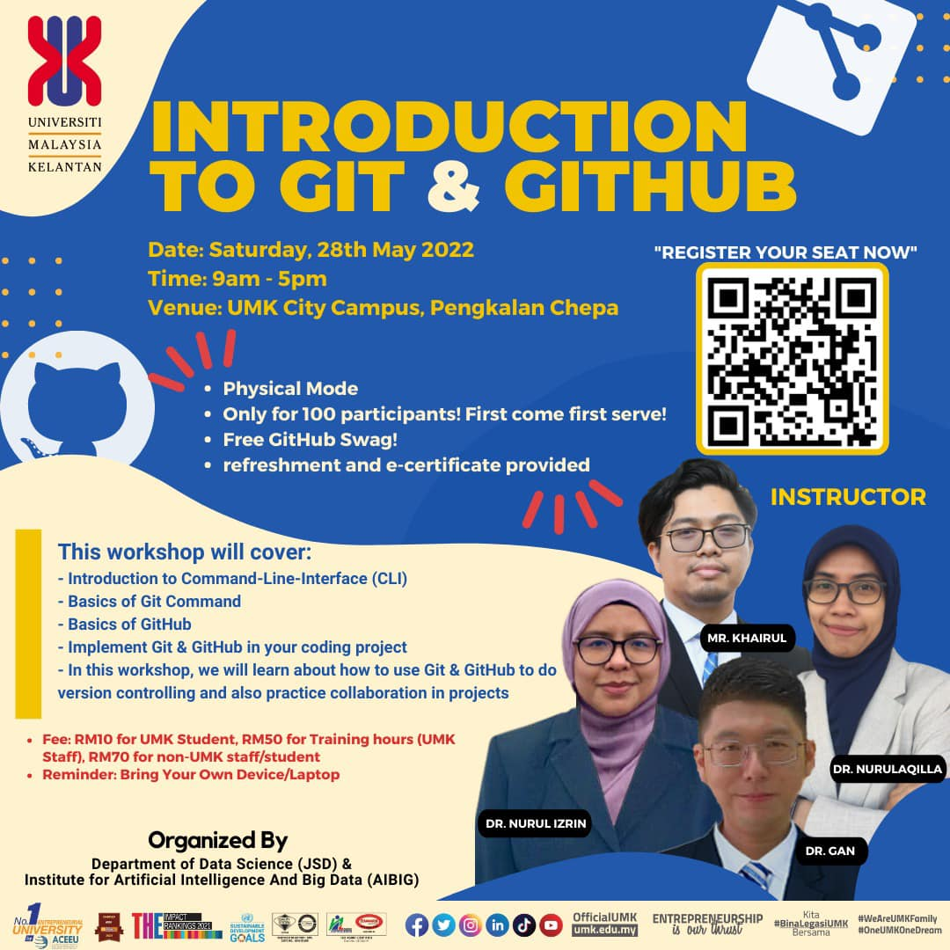
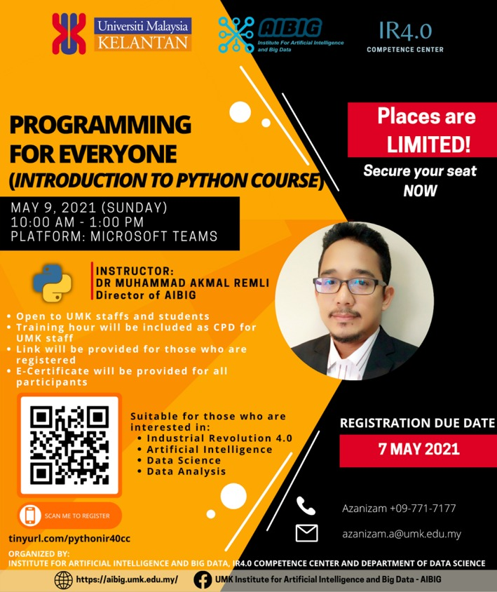
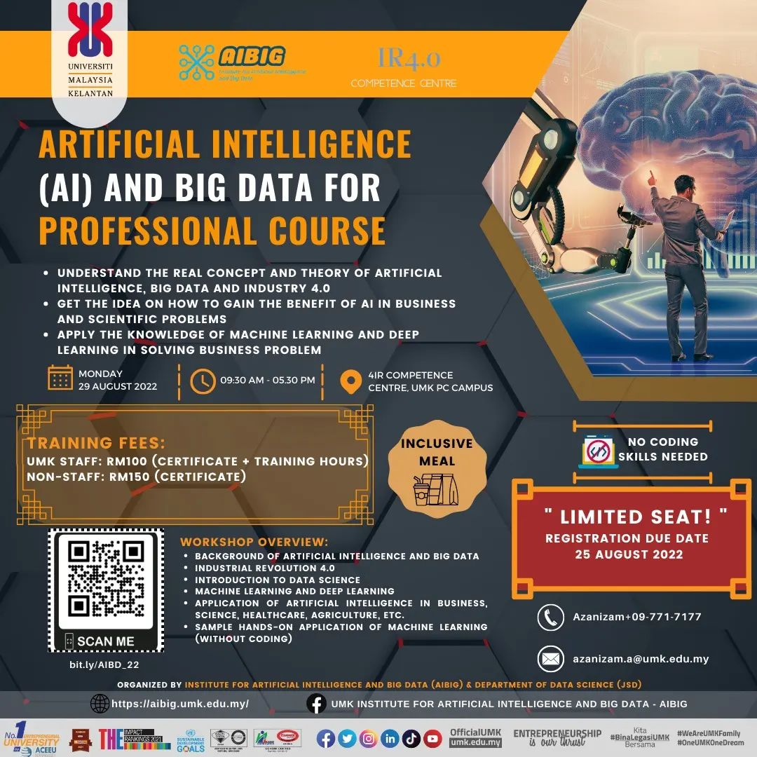
TRAINING 2022
In-Demand Training

Slide 20
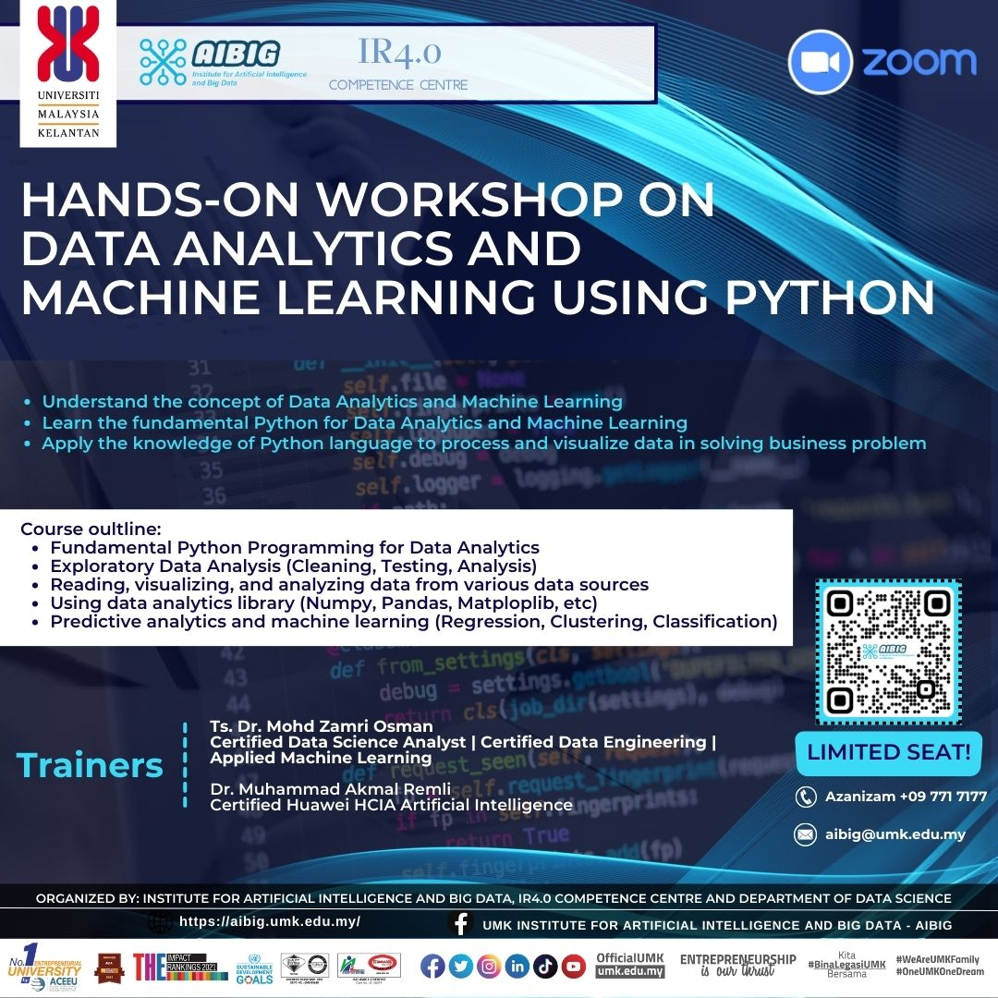
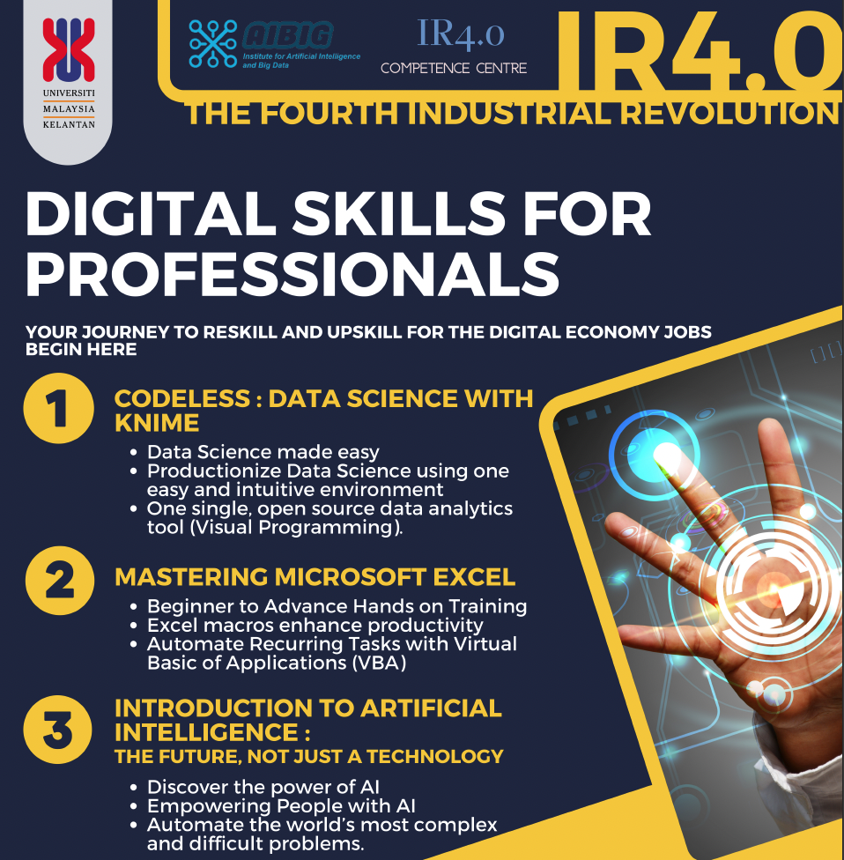
TRAINING 2022
In-Demand Training

Slide 21
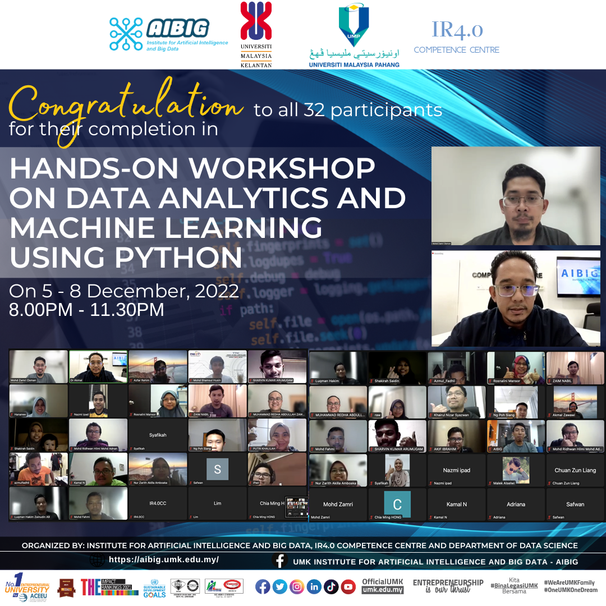
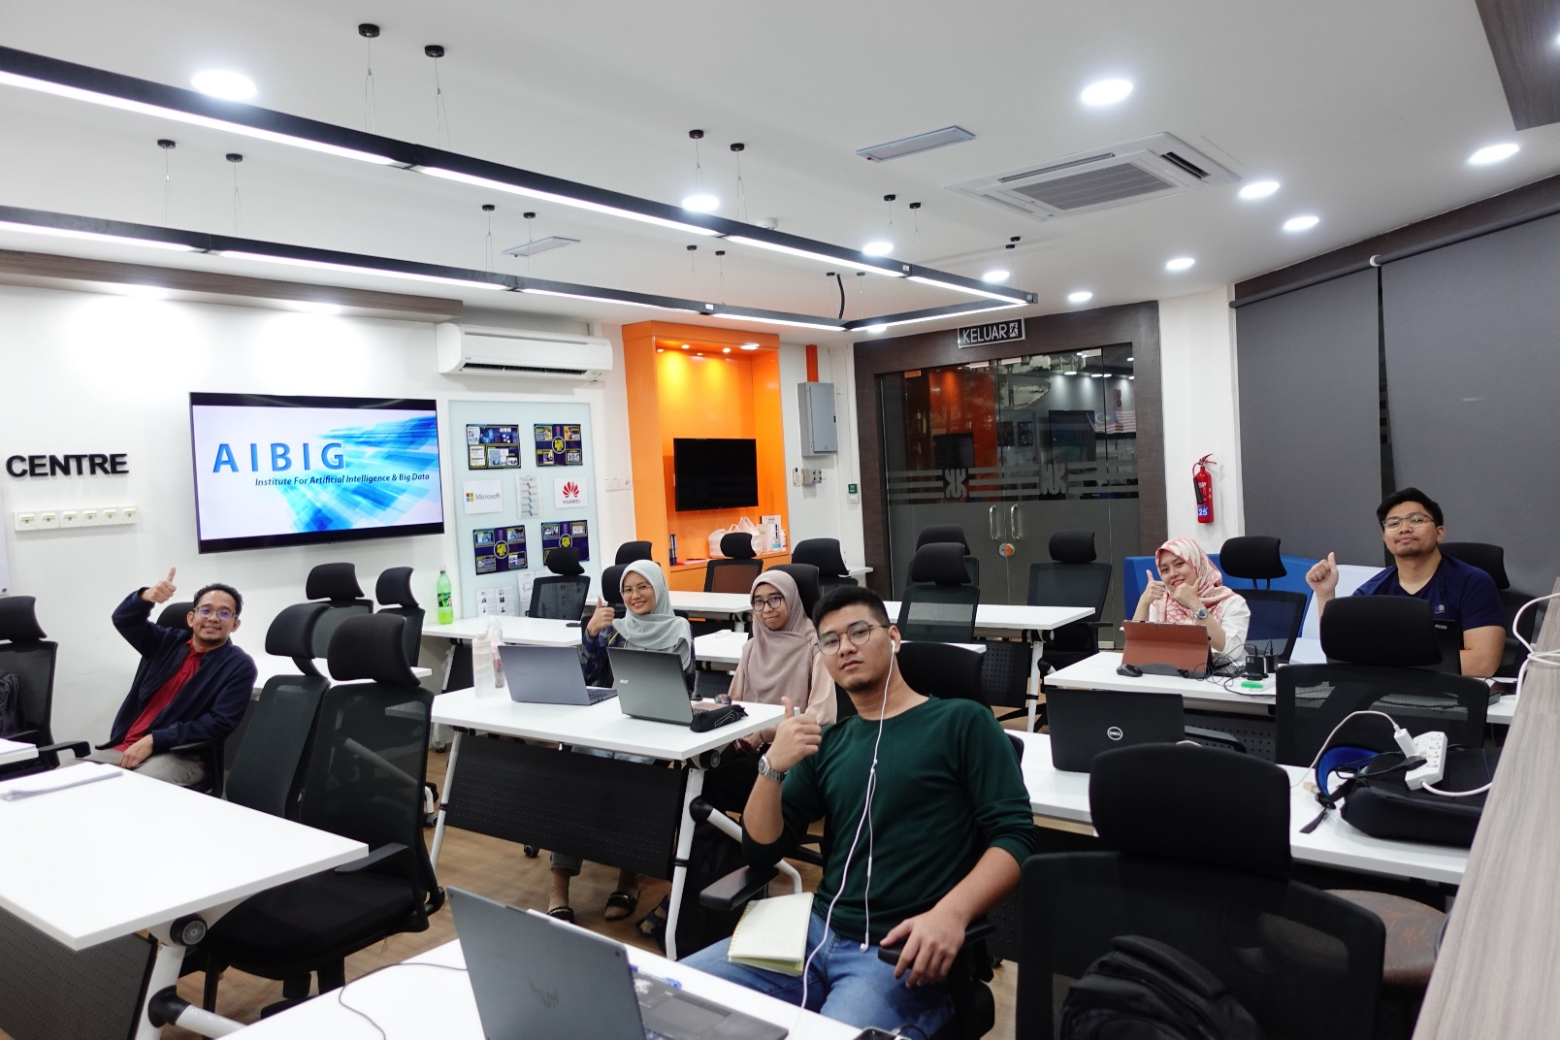
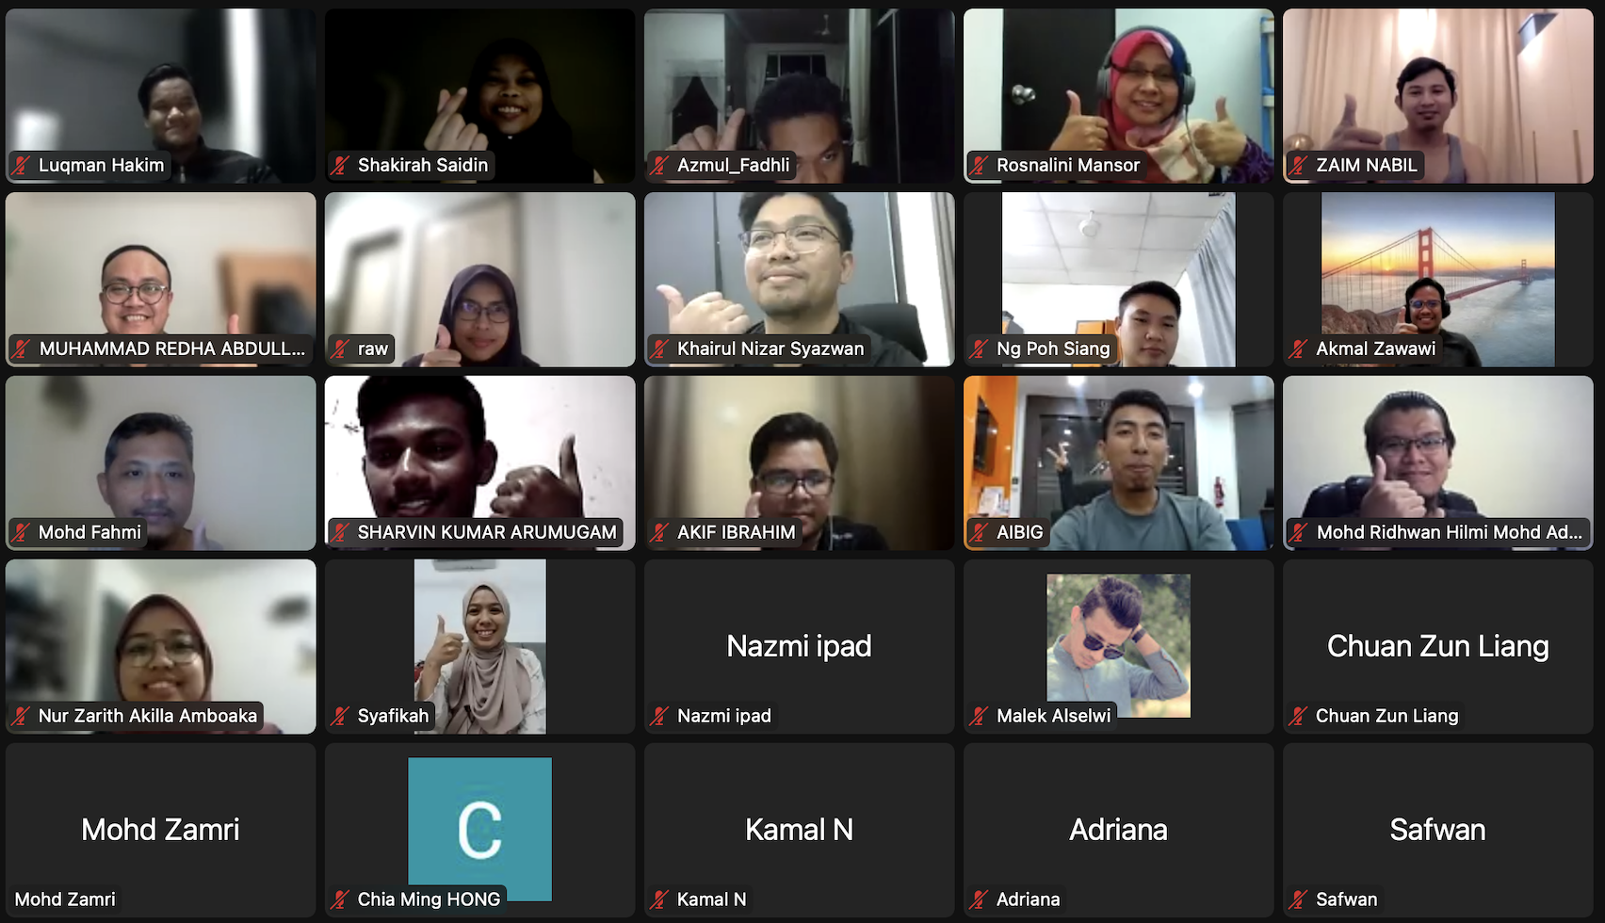
TRAINING 2022

Slide 22
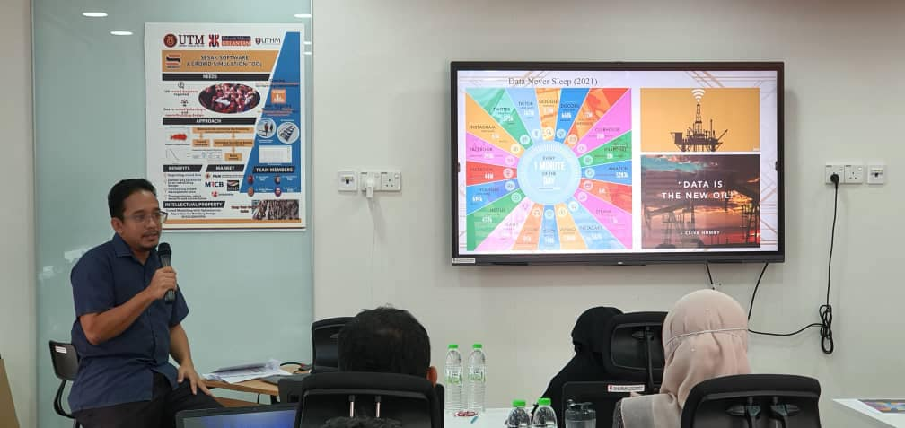
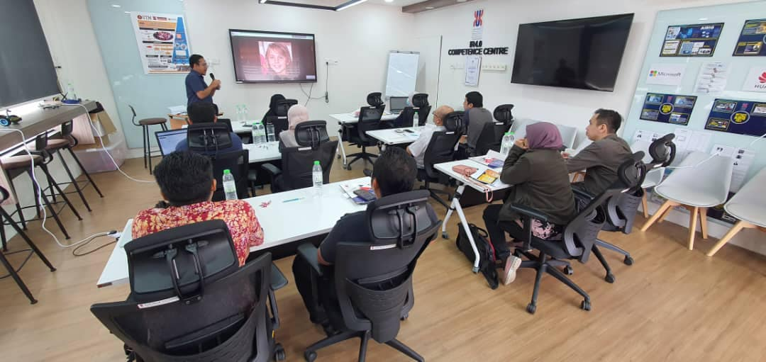
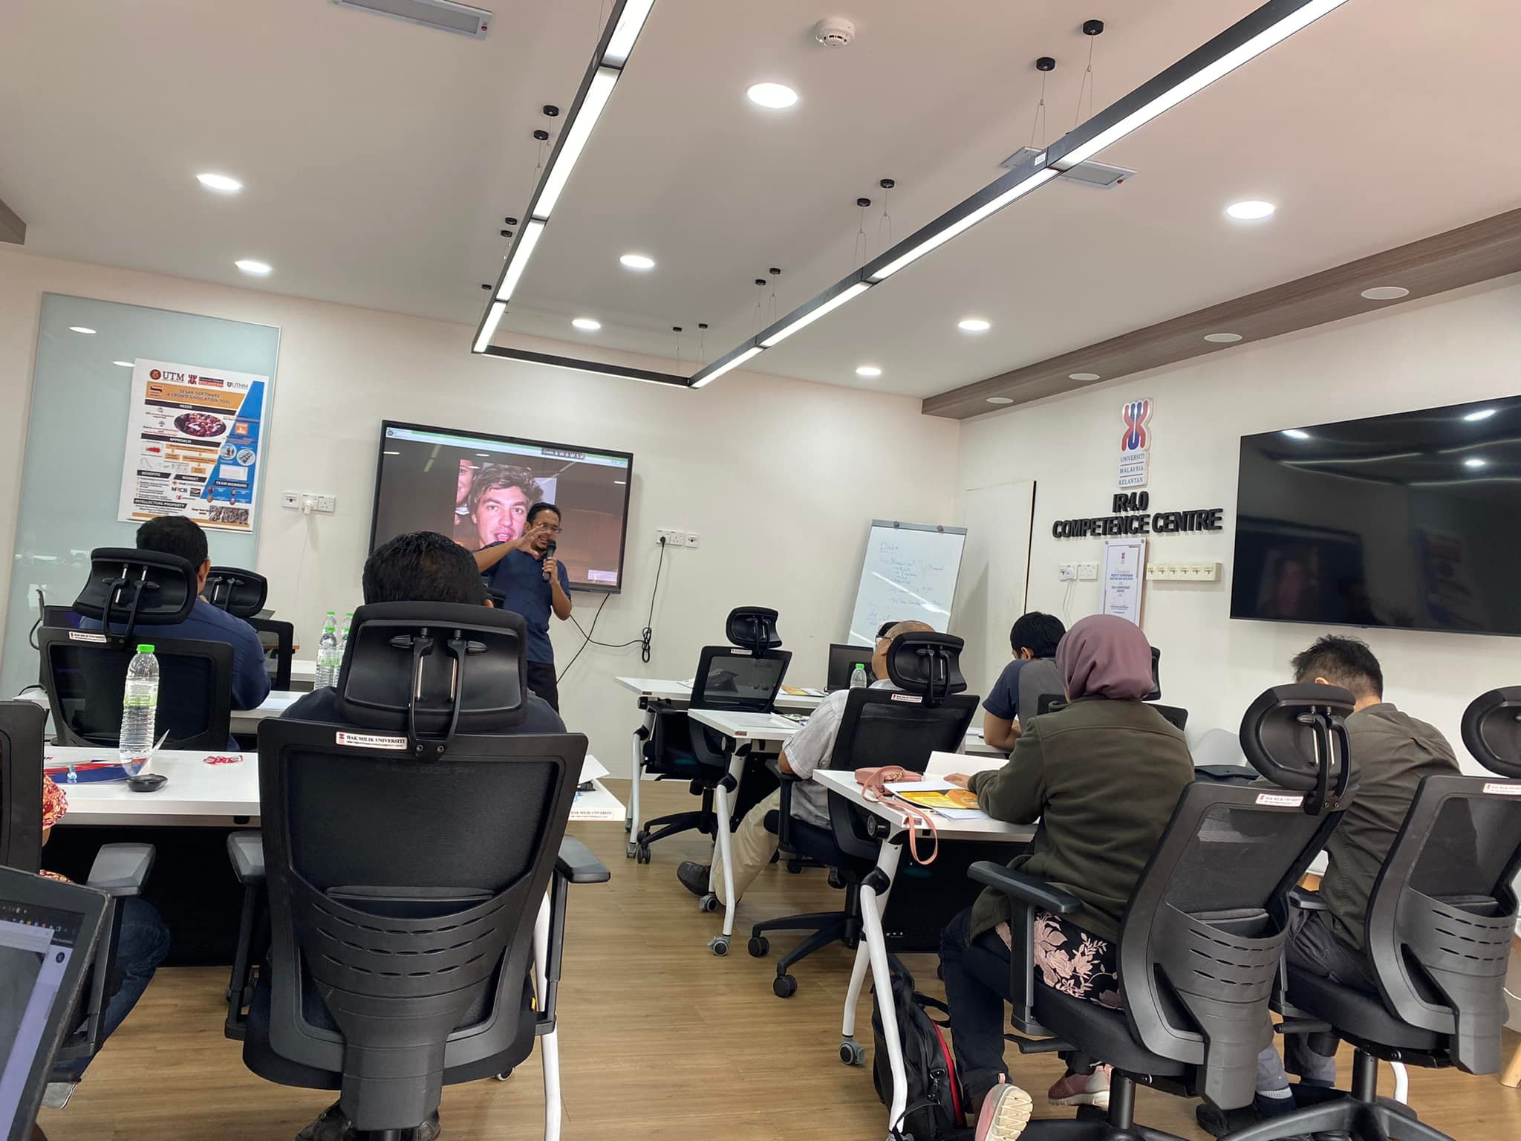
TRAINING 2022 (AI and BIG DATA)
In-Demand Training – Artificial Intelligence & Big Data for Professional Course

Slide 23
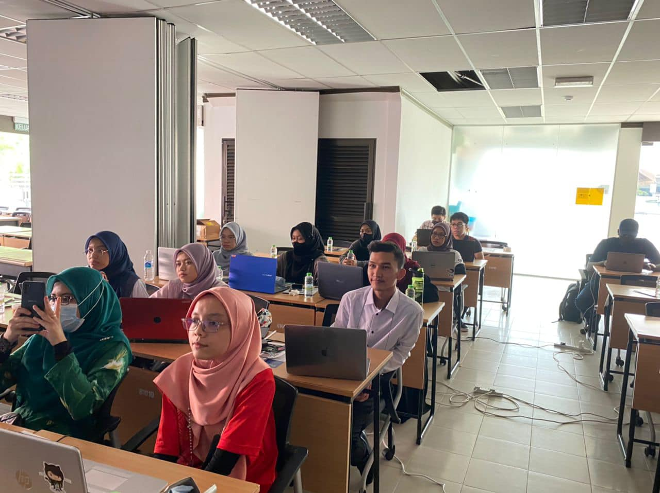




TRAINING 2022 (GITHUB)
In-Demand Training – Introduction to Git & Github

Slide 24





TRAINING AND CONSULTATION 2023 – JABATAN UKUR DAN PEMETAAN MALAYSIA (JUPEM)

Slide 25




TRAINING AND CONSULTATION 2023 – DIGITALIZATION FOR SOCIETY

Slide 26






AIBIG IN MEDIA

Slide 27







INVITED SPEAKERS

Slide 28


Slide 29
AIBIG CORE INITIATIVES 2023
ESTABLISHING:
Funds (Local and International Research Grants, Industry Endowment)
Journal of Artificial Intelligence, Digitalization and Innovative Technology (AIDIT)- Biannual
International Hackathon and Competition on Digitalization and Innovation (IHaC-Digition) - Biennial
Promoting innovation and idealization (primary and secondary school and higher education) – East Coast (Targeting 200 participants)
Tech Theme: AI,BD,IoT,ML,DL,AR,VR,etc
AIBIG Buletin (with ISSN) – Biannual
Digitalization for Society (Empowering Digital Marketing) - Consultation

Slide 30


Slide 31


POTENTIAL COLLABORATION

